Slide 1
Polynomial and Logistic Regression

Slide 2

Polynomial Regression
Used for non-linear relationships
Where h is the degree of the polynomial
h = 2 is quadratic, h = 3 is cubic, h = 4 is quartic, etc.
Allows for a nonlinear relationship, even thought it’s still part of “linear” regression.
Notes:
Very similar to multi-linear regression

Slide 3
Demo
Polynomial CO2 Regression Demo.R

Slide 4
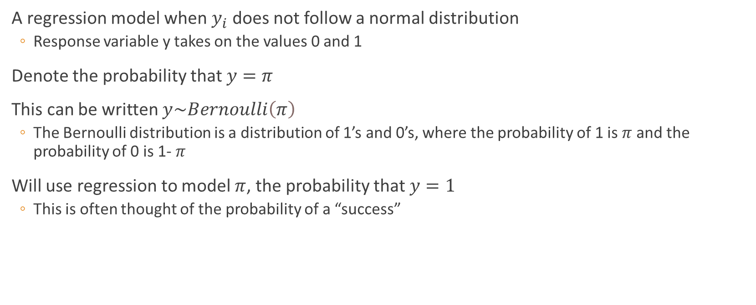
Logistic Regression Model
A regression model when $y_{i}$ does not follow a normal distribution
Response variable y takes on the values 0 and 1
Denote the probability that $y=$ $π$
This can be written $y\sim Bernoulli\left(π\right)$
The Bernoulli distribution is a distribution of 1’s and 0’s, where the probability of 1 is $π$ and the probability of 0 is 1- $π$
Will use regression to model $π$, the probability that $y=1$
This is often thought of the probability of a “success”

Slide 5


Theoretical Logistic Regression Model
Could use this model:
The standard deviation of a Bernoulli distribution is $π\left(1−π\right)$, so $π$ is the only parameter for this distribution
A normal distribution has two parameters, $μ and σ$

Slide 6


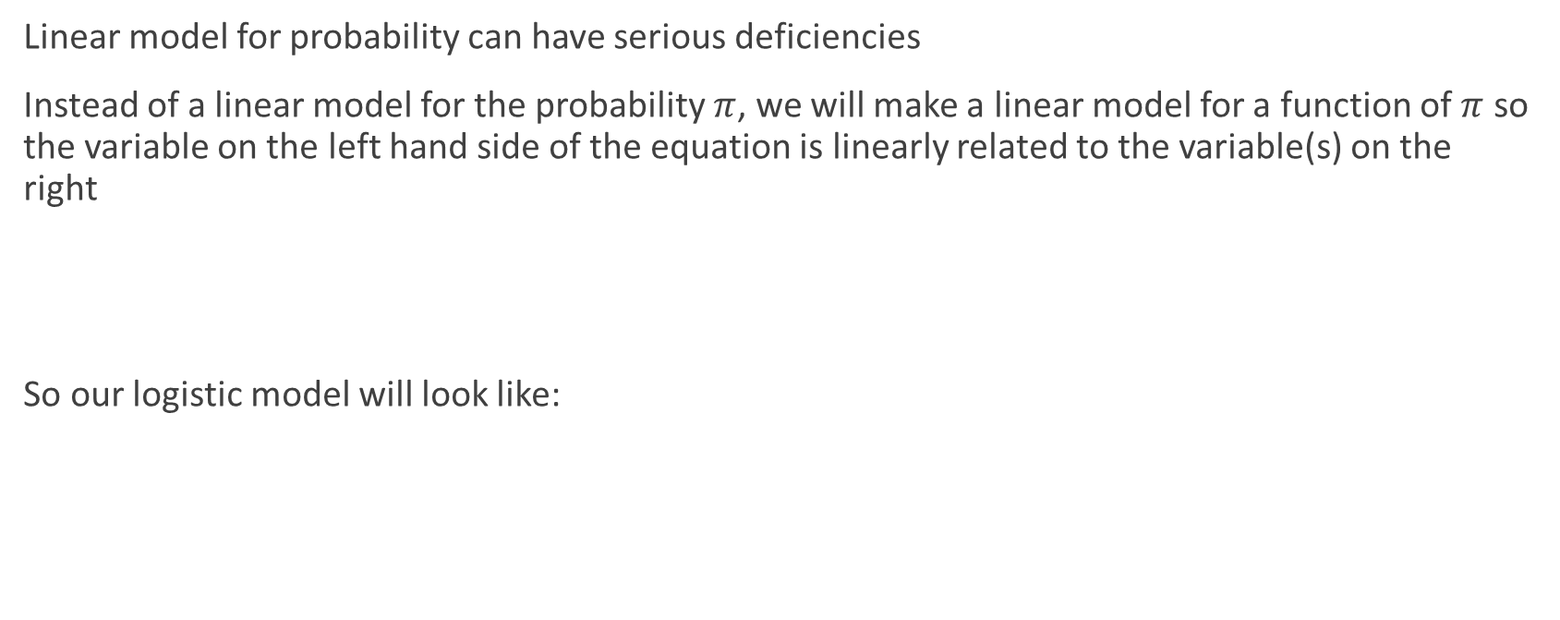
Logit: Log Odds
Linear model for probability can have serious deficiencies
Instead of a linear model for the probability $π$, we will make a linear model for a function of $π$ so the variable on the left hand side of the equation is linearly related to the variable(s) on the right
So our logistic model will look like:

Slide 7
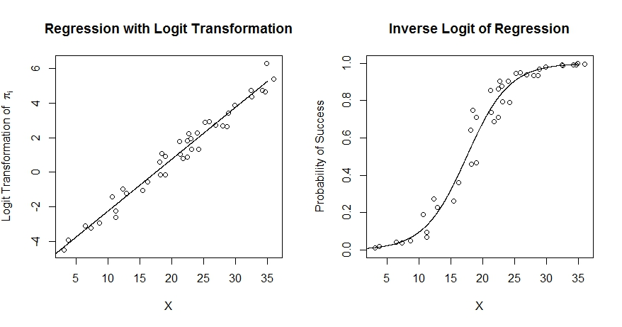
Logit: Log Odds
Logit vs. probability:

Slide 8
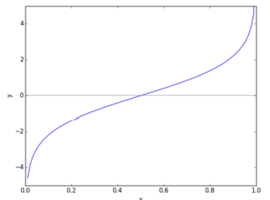
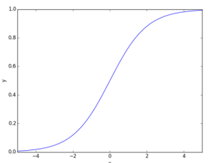
Functions
Logit Function
Logistic function

Slide 9
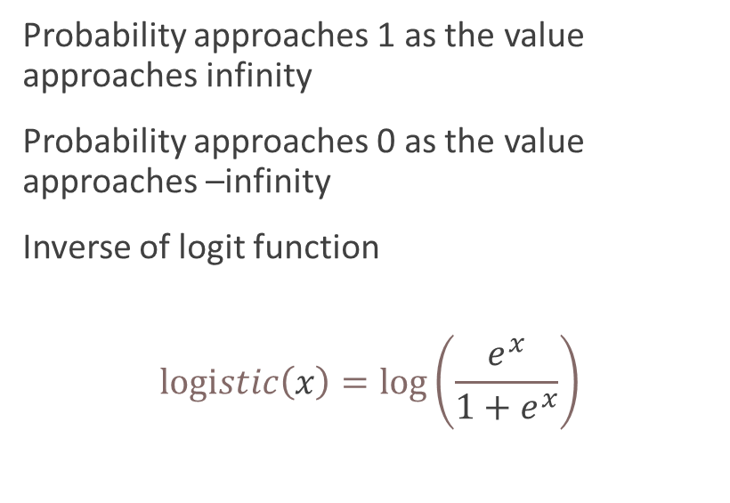
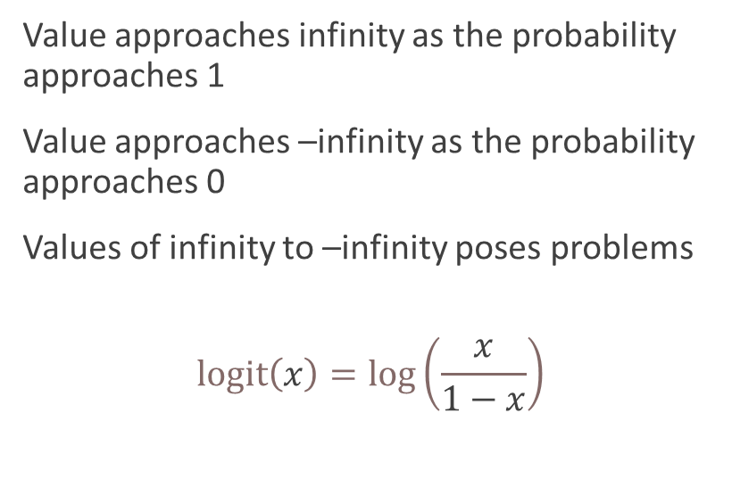
Functions
Logit Function
Logistic function
Value approaches infinity as the probability approaches 1
Value approaches –infinity as the probability approaches 0
Values of infinity to –infinity poses problems
$$logit\left(x\right)=log\left(\frac{x}{1−x}\right)$$
Probability approaches 1 as the value approaches infinity
Probability approaches 0 as the value approaches –infinity
Inverse of logit function
$$logistic\left(x\right)=log\left(\frac{ⅇ^{x}}{1+ⅇ^{x}}\right)$$

Slide 10

Odds vs. Probability
In casual English, “odds” and “probability” are often used interchangeabley
In statistics, they are not the same thing
Odds tell you how likely one outcome is compared to the other
This is the ratio of the probability A occurs to the probability A does not occur
How many times will A occur for every time A does not occur?

Slide 11
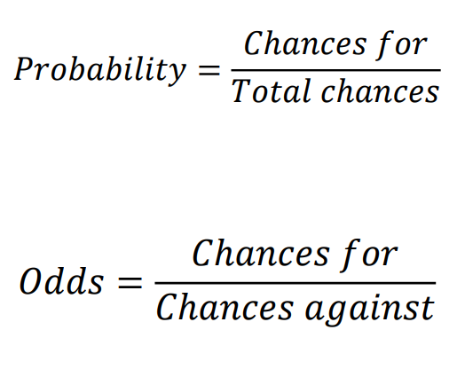
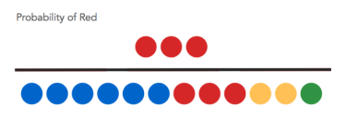

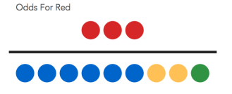

Odds Example

Slide 12



Back to the logistic regression model
We’re not actually interested in “log odds”
We only make the conversation for mathematical convenience… so once we have $logiⅈt\left({\hat{π}}_{i}\right)$ we can get ${\hat{π}}_{i}$ back via the inverse logic function:
In the context of the model:
Multi logistic regression

Slide 13
Assumptions
Independence of cases: Each case is independent of other cases
No multi-collinearity between predictors

Slide 14
Evaluating Models
Can still use AIC and p-values
ROC Curves (receive operator characteristics)
Visualize and measure overall performance
Sensitivity = rate of true positive
Specificity = rate of true negative
AUC
1 means perfect classification
Random guessing is the diagonal line (area of 0.5)
Confusion matrix

Slide 15
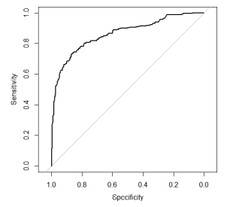
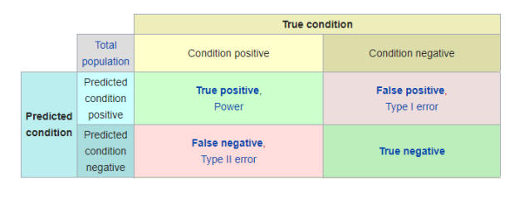
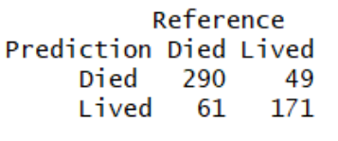
Evaluating Models Examples
ROC Confusion Matrix
AUC

Slide 16
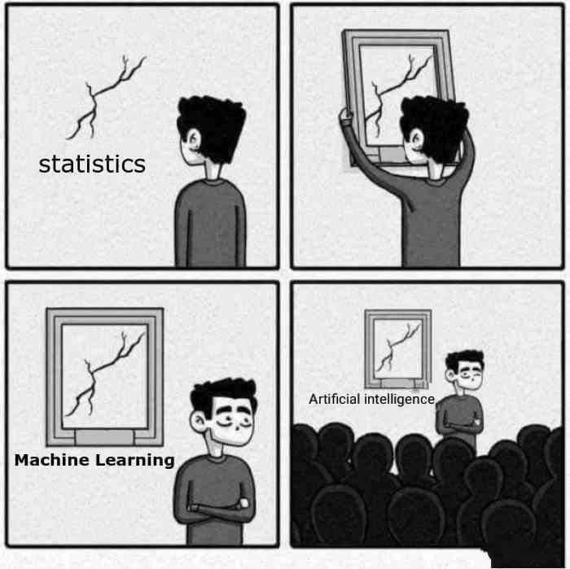
Demo
Titanic.csv
Logistic_regression_Demo.R

Slide 17
In Class Assignment and Homework
In class
Logistic regression on breast_cancer_wisconsin dataset
Post R code and comment the model and its accuracy
Should be a template
Homework
Logistic regression on the churn dataset
churn.csv
Predict if the customer churns (is the churn column a yes or no)

